Slide 1
DSA CS2002
AVL Trees

Slide 2
AVL Trees ref sec 15.1 Data Structures, Algorithms and applications in C++
Trees with worst-case height of O(logn) are called balanced trees.
AVL trees are balanced trees which were introduced in 1962 by two Russian scientists Adelson-Velski and Landis.
Definition: An empty binary tree is an AVL tree. If T is a non-empty binary tree with T_{L} and T_{R} as its left and right subtrees, then T is an AVL tree iff (1) T_{L} and T_{R} are AVL trees and (2) |h_{L}-h_{R} |<=1 where h_{L} and h_{R} are heights of T_{L} and T_{R} respectively.
AVL search tree is a binary search tree that is also an AVL tree.

Slide 3
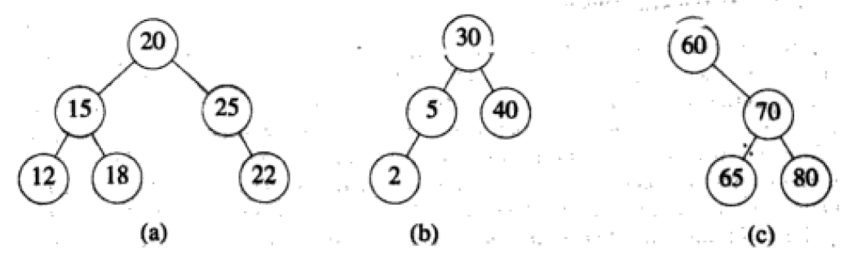
Are the following Binary Trees AVL trees ?

Slide 4
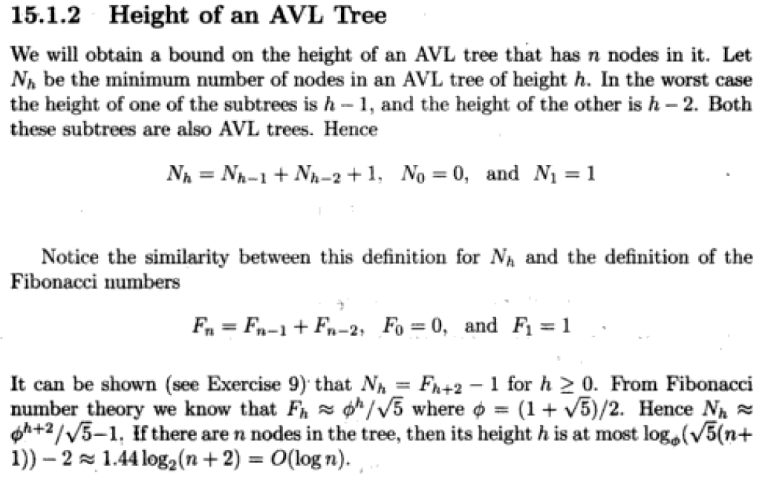

Slide 5
Searching an AVL tree
Search is exactly similar to how it is conducted in a binary search tree (the code may be used as it is)
Since height of AVL tree with n elements is O(logn) therefore search time is also O(logn).

Slide 6
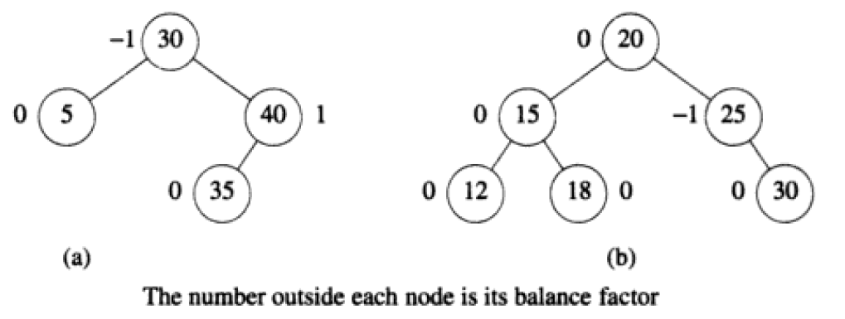
Balance factor of nodes in AVL tree
AVL trees can contain nodes with balance factors of ONLY
-1, 0 or 1

Slide 7
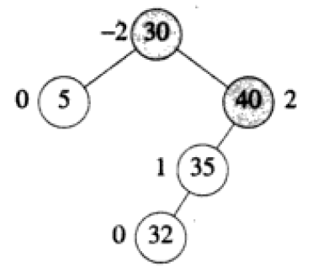
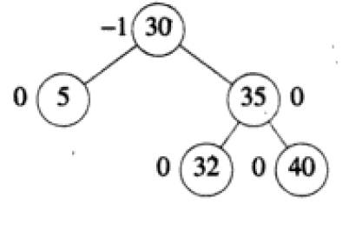
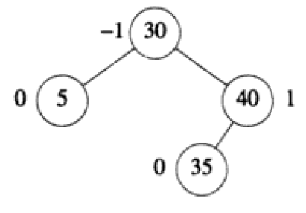
Insertion in an AVL tree
Insertion in an AVL tree proceeds in the same manner as in a Binary Search Tree
If it results in nodes with balance factor other than -1, 0 or 1 then the tree is unbalanced and there is a need to rebalance it.
E.g. when 32 is inserted in the following tree

Slide 8
Steps to rebalance an AVL after insertion if needed
Identify the nearest ancestor of the newly inserted node whose balance factor has become -2 or 2 after insertion. Lets call this node A
Once A has been identified the imbalance can be classified as either L (newly inserted node is in the left subtree of A ) or R type imbalance.
With this refinement of imbalance classification an imbalance at A is either LL (new node is inserted in the left subtree of left subtree of A), LR (new node is inserted in the right subtree of left subtree of A), RR and RL.

Slide 9
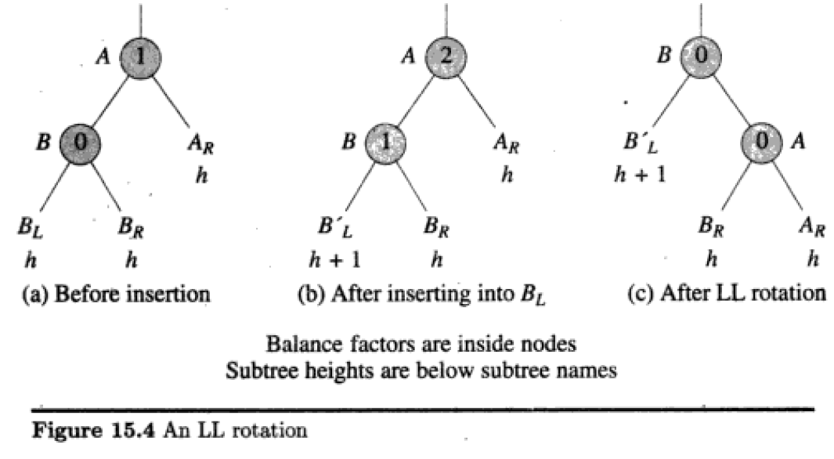

Subtree rotation needed to rebalance an LL type imbalance

Slide 10
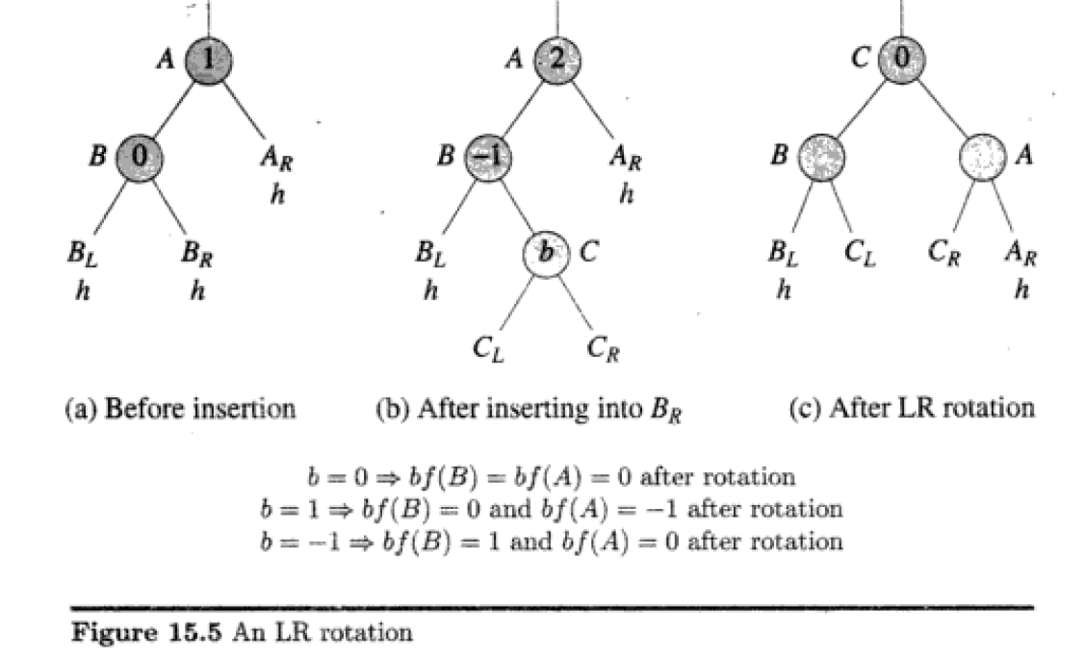

Subtree rotation needed to rebalance an LR type imbalance

Slide 11

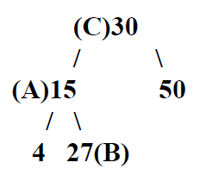
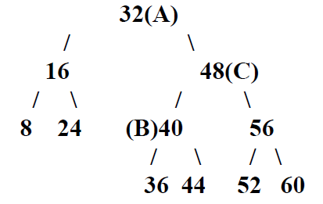
Insert 10 in the following AVL tree
Insert 20 in the following AVL tree
Insert 46 in the following AVL tree

Slide 12
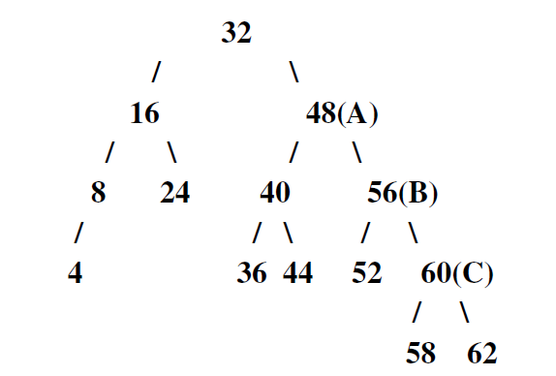
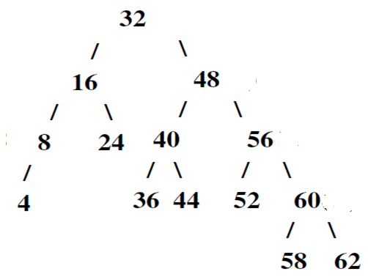
Insert 61 into the following AVL tree

Slide 13
Deletion from an AVL tree
In case of AVL tree deletion proceeds in the same manner as in a Binary Search tree (in which case only nodes of degree 0 or 1 get physically deleted).
If a delete causes violation of the AVL tree height property this would have to occur on some node on the path from the parent of the deleted node. Let q be this node.
Let A be the first node encountered on the path from q to the root which is unbalanced (i.e. With balance factor -2 or 2)
This imbalance is classified as type L if deletion took place from left subtree of A, and R if it took place from the right subtree.

Slide 14
Deletion from AVL tree (R-type imbalance)
An R type imbalance is further classified as R0, R-1 or R1 type imbalance depending on the balance factor of the root of left subtree
The rotations needed to rebalance the tree for R0 and R1 type imbalance is similar to LL type rotation
The rotation needed to reblance R-1 type imbalance is similar to LR type rotation
Unlike insertion, one rotation may not suffice to restore balance following a deletion. The number of rotations that might be needed is O(logn).

Slide 15
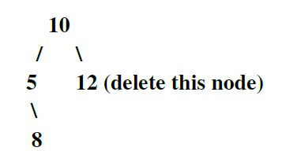
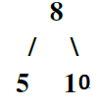
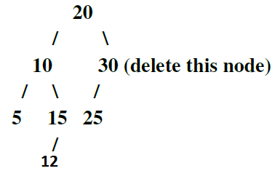
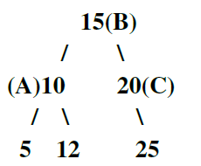
Deletion Examples

Slide 16
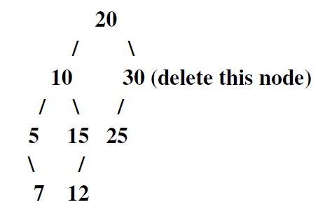
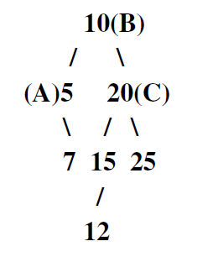
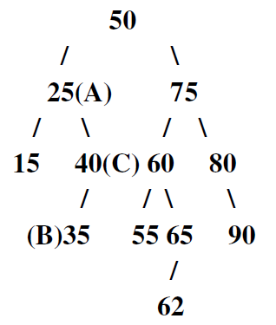
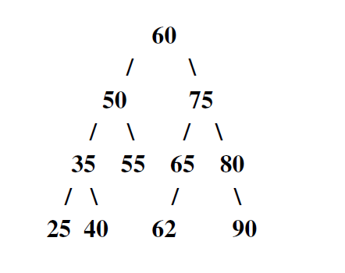
Delete 15

Slide 17
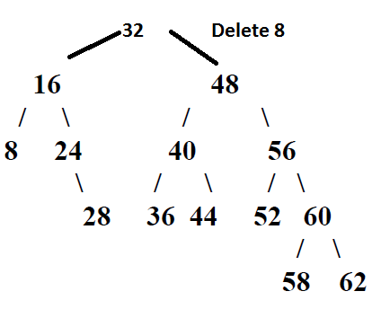
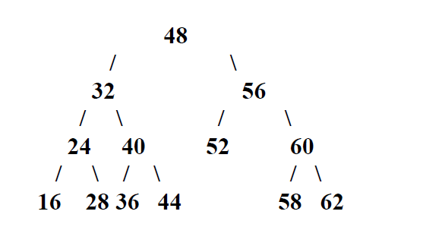

Slide 18
